Slide 1
Transport Layer in WSN

Slide 2
Main Objectives and Challenges
Objectives:
Congestion control
Reliable transport
(De)multiplexing
Challenges
End-to-End Measures
Application-Dependent Operation
Energy Consumption
Biased Implementation
Constrained Routing/Addressing

Slide 3
End-to-End Measures
Traditional TCP
Adopts end-to-end retransmission-based error control and window-based additive-increase multiplicative-decrease (AIMD) congestion control mechanisms.
Provides end-to-end and point-to-point reliability and congestion control solutions.
Packet losses and congestion mitigation are performed through communication between a source and a destination without any involvement from the intermediate parties.
Reside only on the source and destination.
Each ﬂow is considered independently to provide a point-to-point communication solution.
TCP for WSN
End-to-end control mechanisms leads to resource wastage in WSNs, where collective information from a group of sensors is much more important than the individual information from each sensor node.
If local measures for reliability and congestion control are employed it can improve the energy efﬁciency of the transport layer protocols.
Reliability of the collective information from a group of sensors is controlled instead of the reliability of information from each individual sensor node.

Slide 4
Application-Dependent Operation
Operation of WSNs are for a speciﬁc sensing application objective.
For a monitoring application reliability is the most important metric
For event detection applications timeliness is crucial.
Focus of the transport layer solutions should be tailored to the application.
The application can be developed for a wide range of purposes in the military, environment, health, space exploration, and disaster relief areas.
The importance of these metrics also varies according to the application area.
Objective of WSNs inﬂuences the design requirements of the transport layer protocols.

Slide 5
Energy Consumption
Transport layer functionalities should be energy aware, i.e., the error and congestion control objectives must be achieved with the minimum possible energy expenditure.
If reliability levels at the sink are found to be in excess of that required for event detection, the source nodes can conserve energy by reducing the amount of information sent out or temporarily powering down.
End-to-end measures used for conventional networking for reliability, requires signiﬁcant energy consumption in a multi-hop network. These solutions are not be scalable for WSNs.
Transport layer protocol can be designed such that the reliability level can be traded off for decreased energy consumption through local reliability measures.

Slide 6
Biased Implementation
Most of the functionalities should be performed at the sink with minimum functionalities required at the sensor nodes to conserve limited sensor resources and shifts the burden to the high-powered sink.
Moreover, the trafﬁc in the WSNs exhibits signiﬁcantly different characteristics depending on the ﬂow direction.
While the ﬂow in the sensors-to-sink direction may require timely delivery with loss-tolerant operation, the sink-to-sensors direction usually requires a high delivery ratio.
Transport protocols should be designed also by considering these biases in trafﬁc.

Slide 7
Constrained Routing/Addressing
The design of transport layer protocols for WSNs should not assume the existence of an end-to-end global addressing
It may have attribute-based naming and data-centric routing, which call for different transport layer approaches.

Slide 8
Transport Protocols for WSN
Reliable Multi-Segment Transport (RMST)
Pump Slowly, Fetch Quickly (PSFQ)
Congestion Detection and Avoidance (CODA)
Event-to-Sink Reliability (ESRT),
GARUDA and
Real-Time and Reliable Transport (RT)²

Slide 9
Reliable Multi-Segment Transport (RMST) Protocol
End-to-end data-packet transfer reliability
Each RMST node caches the packets
When a packet is not received before the WATCHDOG timer expires, a NACK is sent backward
The first RMST node that has the required packet along the path retransmits the packet
In-network caching brings significant overhead in terms of power and processing
Relies on Directed Diffusion
Placement of reliability for data transport at different layers of the protocol stack
MAC layer
Transport layer
Application layer
Combinations of above
Trade-off between implementation on the MAC vs Transport layer

Slide 10
RMST
Implemented as a filter for Directed Diffusion
Takes advantage of Directed Diffusion for
Routing
Path recovery and repair
Adds to Directed Diffusion
Fragmentation/reassembly management
Guaranteed delivery
Receivers responsible for fragment retransmissions
Receivers are not necessarily end points
Caching or non-caching mode determines classification of node
Two types of loss detected by a “receiver”
A “hole” in a sequence of fragments
A truncated sequence
RMST considers 3 layers
MAC
Transport
Application

Slide 11
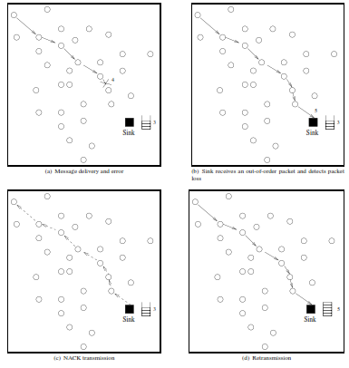
Error Recovery in non-caching mode

Slide 12
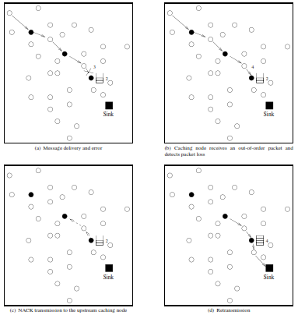
Error Recovery in caching mode

Slide 13
RMST
MAC Layer Choices
No ARQ
All transmissions are broadcast
No RTS/CTS or ACK
Reliability deferred to upper layers
Benefits: no control overhead, no erroneous path selection
ARQ always
All transmissions are unicast
RTS/CTS and ACKs used
One-to-many communication done via multiple unicasts
Benefits: packets traveling on established paths have high probability of delivery
Selective ARQ
Use broadcast for one-to-many and unicast for one-to-one
Data and control packets traveling on established paths are unicast
Route discovery uses broadcast

Slide 14
RMST
Transport Layer Choices
End-to-End Selective Request NACK
Loss detection happens only at sinks (endpoints)
Repair requests travel on reverse (multi-hop) path from sinks to sources
Hop-by-Hop Selective Request NACK
Each node along the path caches data
Loss detection happens at each node along the path
Repair requests sent to immediate neighbors
If data is not found in the caches, NACKs are forwarded to next hop towards source
Application Layer Choices
End-to-End Positive ACK
Sink requests a large data entity
Source fragments data
Sink keeps sending interests until all fragments have been received
Used only as a baseline

Slide 15
RMST
NACKs triggered by
Sequence number gaps
Watchdog timer inspects fragment map periodically for holes that have aged for too long
Transmission timeouts
“Lost fragment” problem
NACKs propagate from sinks to sources
Unicast transmission
NACK is forwarded only if segment not found in local cache
Back-channel required to deliver NACKs to upstream neighbors

Slide 16
Qualitative Evaluation of RMST
Benefits
In caching mode, RMST essentially creates reliable segments between two consecutive caching nodes and the retransmissions are performed inside these segments instead of through the end-to-end route.
As a result, the cost associated with end-to-end retransmissions is minimized. Moreover, RMST aims to provide guaranteed delivery for each ﬂow in the WSN.
This is helpful for applications where individual node information is important, such as in network management solutions.
Drawbacks
May incur additional overhead since caching requires additional processing and memory at the caching nodes. This may increase the overall complexity and energy consumption of the network.
Most applications may not require 100% reliability
RMST treats each ﬂow separately, which may lead to overutilization of the resources in WSNs.
Guaranteed reliability via in-network caching may bring signiﬁcant overhead for WSNs with power and processing limitations.
Focuses only on the reliability aspects of communication. Since a packet-by-packet reliability notion is followed, a large amount of information may ﬂow inside the network. This will result in congestion and associated packet drops, which is not addressed in RMST.

Slide 17
Pump Slowly, Fetch Quickly (PSFQ)
Address the path from sink to sensors
Pace the data from a source node at a relatively low speed to allow intermediate nodes to fetch missing data segments from their neighbors
Assumption: no congestion, losses due only to poor link quality
Hop-by-hop recovery
Goals
Recover from losses locally
Ensure data delivery with minimum support from transport infrastructure
Minimize signaling overhead for detection/recovery operations
Operate correctly in poor link quality environments
Provide loose delay bounds for data delivery to all intended receivers

Slide 18
PSFQ
Three basic operations
Pump: Slow pumping → Each node on the route to the destinations waits for a speciﬁc amount of time before relaying the messages.
Fetch: In case of packet errors, each node performs aggressive hop-by-hop recovery to fetch the lost packets from neighbor nodes.
Status reporting: Provides a reporting functionality that creates closed-loop communication between sensors and sink. Through this functionality, the sink can collect information related to operation of the network.
Alternate between multi-hop forwarding when low error rates and store-and-forward when error rates are higher

Slide 19
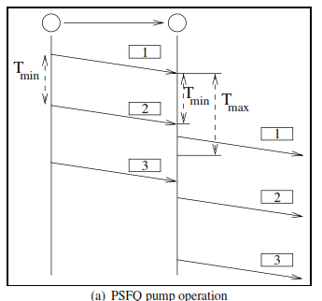

Slide 20
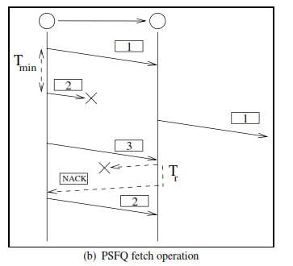

Slide 21
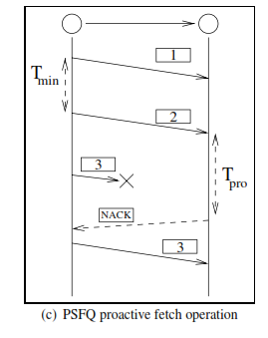

Slide 22
Report Operation
Used to provide feedback data of delivery status to source nodes
To minimize the number of messages, a report message travels back from a destination node to the source nodes
Intermediate nodes can piggyback their report messages in an aggregated manner
If report message is not received within T_{report} time the node generates its report and send it to the sink

Slide 23
Qualitative Evaluation
Lightweight and energy efficient
Simple mechanism
Scalable and robust
Need to be tested for high bandwidth applications
Cache size limitation
Does not address congestion control

Slide 24
Congestion Detection and Avoidance (CODA)
Aim → To detect and avoid congestion in WSNs
Three main congestion scenarios
For traffic generation from source node, congestion builds up close to the source nodes because of the contention in the wireless channel → local congestion control mechanisms
For low-rate trafﬁc, congestion can occur temporarily in hot spots, where multiple ﬂows are served → local congestion control mechanisms
For traffic from persistent hot spots requires end-to-end mechanisms to regulate the data rate of source nodes.
Congestion Control Mechanisms
Receiver-based congestion detection
Open-loop hop-by-hop backpressure signaling to inform the source about the congestion,
Closed-loop multi-source regulation for persistent and larger scale congestion conditions.

Slide 25
CODA
Congestion Detection Metric
Receiver based congestion detection mechanism
Buffer occupancy level
If the unused buffer level drops below a threshold level
Channel Load Condition
if the channel load is higher than a fraction of the maximum channel utilization

Slide 26
Open-loop hop-by-hop back pressure
When a sensor node is trying to transmit a packet to the sink through a congested area and when the congestion is detected by one of the nodes inside the congested area the receiver broadcasts a suppression message toward the source node in the reverse path.
The suppression message is used to inform the upstream nodes about congestion.
Upon receiving the suppression, the upstream nodes decrease their sending rates or drop packets to relieve the congestion in the forward path.
The suppression message is rebroadcast until a non-congested node receives the message
The suppression message may not reach all the way to the source nodes, they serve to relieve local congestion in a hot spot area.
By using cross-layer routing techniques the forward path can be rerouted to avoid these hot spots.

Slide 27
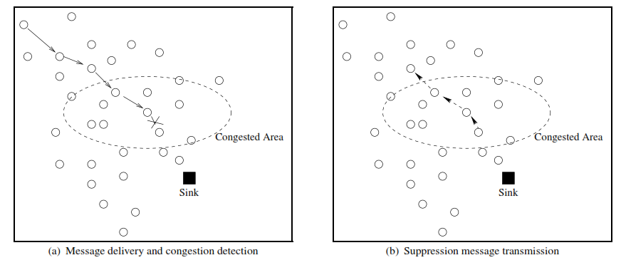
Open-loop hop-by-hop back pressure

Slide 28
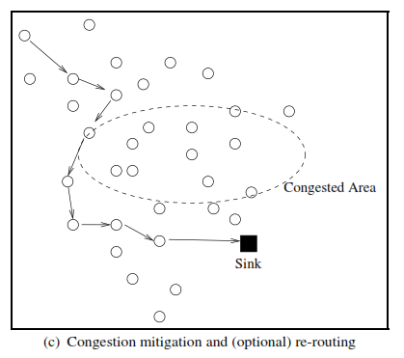

Slide 29
Closed loop multi-source regulation
The trafﬁc generated by the source nodes can create network-wide congestion.
If a source node injects a trafﬁc load larger than the network can handle, the local congestion control mechanism cannot relieve the congestion.
Similar to conventional end-to-end congestion control mechanisms.
If the source rate exceeds a threshold, r >= νS_{max} the source node enters closed-loop control.
A regulation bit is set in the header of the packets to inform the sink.
The sink begins sending periodic ACK messages for each n number of packets received.
If the source cannot receive the ACK messages, it determines network-wide congestion and decreases its source rate.
S_{max} → maximum theoretical throughput of the channel

Slide 30
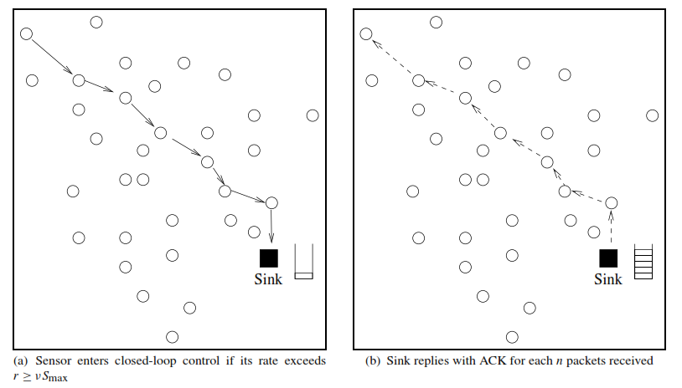
Closed loop multi-source regulation

Slide 31
Qualitative Evaluation
Advantages
Congestion is predicted more precisely by using a combination of buffer occupancy level and channel load condition
Addresses both local and end-to-end congestion and hence a complete congestion control mechanism is provided for downstream trafﬁc.
It can increase the network performance by avoiding congestion.
Disadvantages
Does not address end-to-end transport reliability
Closed-loop multi-source regulation mechanism incurs additional latency for cases where the network trafﬁc is high.

Slide 32
Event-to-Sink Reliable Transport (ESRT) Protocol
Based on the event-to-sink reliability notion and provides reliable event detection without any intermediate caching requirements.
Address both the reliability and congestion problems
Main characteristic of information delivery in WSN
Data-centric
Collective information from multiple sensors regarding an event is much more important than the individual information sent from each node.
Not a source to a destination flow, but an event-to-sink information ﬂow
Algorithms run mainly on the sink, with minimal functionality required at resource-constrained sensor nodes.
Relies on the sink to measure the reliability in the WSN every t time units, i.e. decision interval.

Slide 33
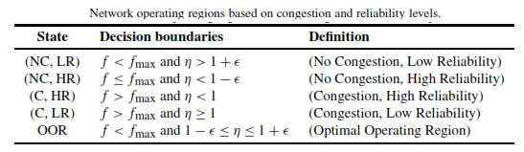
ESRT
Reliability is measured in terms of the number of data packets from all the sensor nodes associated with an event.
Observed event reliability, r_{i} , is the number of received data packets in decision interval i at the sink.
Desired event reliability, R_{i}, is the number of data packets required for reliable event detection. This is determined by the application.
Conﬁgures the reporting rate, f, of source nodes so as to achieve the required event detection reliability, R, at the sink with minimum resource utilization.

Slide 34
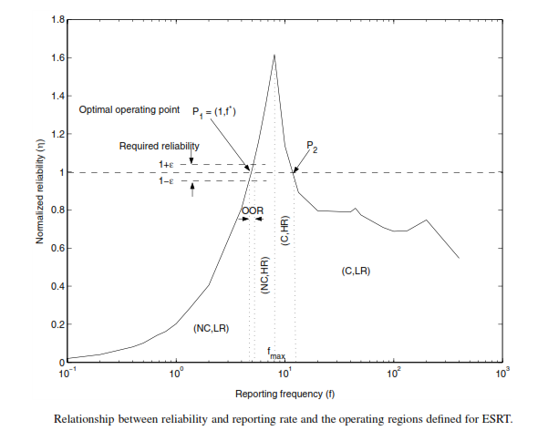

Slide 35
To control congestion in the network, the sink needs to determine the operating region of the network.
This operating region depends on two factors: whether congestion exists in the network and whether the required reliability is achieved.
Two mechanisms are required to estimate the congestion and the reliability state of the network.
In each decision interval, t, the sink determines whether the network is operating in the low- or high-reliability region according to the number of packets received in that interval.
A congestion detection algorithm is employed at each sensor node in the network.
The sink determines the operating region of the network.
According to the operating region, the sink controls the reporting rate of the sensor nodes to operate at the optimal operating region (OOR).

Slide 36
For congestion detection
Each sensor node monitors the local buffer-level
The increment in the buffer fullness level at the end of each reporting interval is expected to be constant.
b_{k} = buffer fullness level at the end of k^{th} reporting level
b_{k-1} = buffer fullness level at the end of (k-1)^{th} reporting level
Δb = b_{k} - b_{k-1}
B = Buffer size
If b_{k} + Δb > B → congestion in the next reporting interval.
If a sensor node detects congestion in the network, it notiﬁes the sink by piggybacking the packets that are sent.
The state of the network is determined at each decision interval through the reliability measurement and congestion notiﬁcations.
The sink updates the reporting rates of the sensor nodes by broadcasting a packet to each sensor node.
f_{i} = reporting rate in decision interval i
η_{i} = reliability level in decision interval i

Slide 37
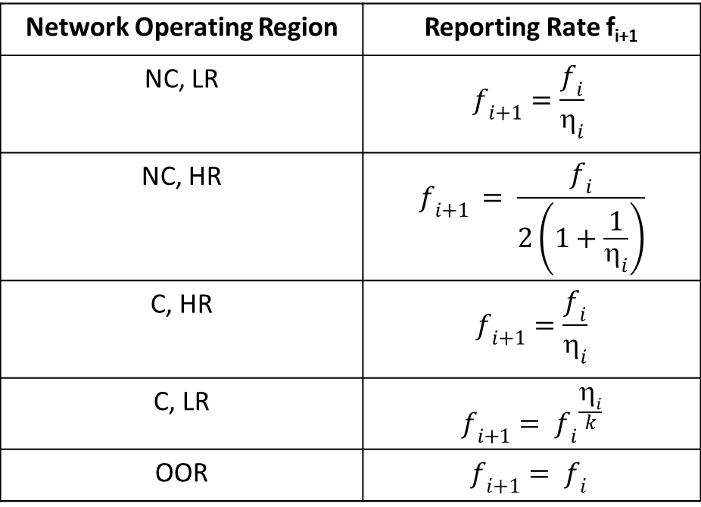
Reporting Rate Decision
Network Operating Region | Reporting Rate f_{i+1}
NC, LR | $$f_{i+1}=\frac{f_{i}}{{\text{η}}_{i}}$$
NC, HR | $$f_{i+1 }= \frac{f_{i}}{2\left(1+\frac{1}{η_{i}}\right)}$$
C, HR | $$f_{i+1}=\frac{f_{i}}{{\text{η}}_{i}}$$
C, LR | $$f_{i+1}= {f_{i}}^{\frac{η_{i}}{k}}$$
OOR | $$f_{i+1}= f_{i}$$

Slide 38
Qualitative Evaluation
Advantages
Introduces a novel reliability notion event-to-sink reliability.
Efﬁcient congestion control and reliability mechanisms are provided by shifting the decision mechanism to the power-rich sink node.
Achieves both reliability and conserving energy.
The required reliability is achieved with minimum energy consumption and without network congestion.
Through distributed update mechanisms, ESRT converges to the optimum operating state regardless of the initial network state.

Slide 39
Disadvantages
It relies on the assumption that the base station is one hop away from all the sensor nodes, i.e., a sink broadcast for frequency update will be received by all sensor nodes. Although this assumption may hold true for a certain class of application, as the network size increases, multi-hop strategies are required for information delivery from the sink to the sensors.
ESRT maintains the same value of operating frequency, f , at the end of each decision interval for each sensor node. In case a large group of sensors sense an event, the required operating frequency may not be the same for all these sensors because of their local interactions in the network.
The event-to-sink reliability notion applies to cases where the information at each sensor is correlated.
It cannot be applied for applications where individual sensor information is necessary.

Slide 40
Real Time Reliable Transport (RT²)Protocol
Reliably and collaboratively transport event features from the sensor field with minimum energy dissipation in a timely manner
Addresses both congestion control and reliability
First protocol to focus on real-time guarantees
Challenges
Timely delivery → Delay based reliability
Channel errors and node failures → Packet level reliability mechanism at Transport Layer
Energy Efficiency → Energy aware protocol

Slide 41
(RT²)Protocol
Follows collective event transport reliability as in ESRT
Event delay bound → To meet application specific deadlines
Definitions
Observed delay-constrained Event Reliability (DR_{i})→ No. of packets received with a certain delay bound at the sink in a decision interval i.
Desired delay-constrained Event Reliability (DR*) → Min. no. of packets required for reliable event detection within a certain application specific delay bound.
Delay-constrained Reliability Indicator (δ_{i})→ DR_{i}/DR*

Slide 42
For each decision interval i, the sink observes DR_{i}
DR_{i} > DR* → Event is reliably detected within delay bound
Otherwise adjust reporting rate f
RT²
To configure the reporting rate, f, of source nodes so as to achieve the required event detection reliability, DR*, at the actor node within the application-specific delay bound
Delay-constrained reliability - Δ_{e2a}
Event Transport Delay (Γ^{tran}) – Overall time between the event occurrence time and the time when the event is reliably transported to the sink.
Buffering delay
Channel access delay
Propagation delay
Event Processing Delay (Γ^{proc}) – Processing delay experienced at the sink when the desired features of the event are estimated using the data packets received from the sensor field. Includes the duration of wait to receive adequate samples from the sensor nodes.
Action delay (Γ^{act}) – Time taken from the instant when an event is reliably detected at the sink to the instant when a particular action is performed
Δ_{e2a} >= Γ^{tran} + Γ^{proc} + Γ^{act}

Slide 43
Γ^{tran} depends on network load and congestion level
Network load depends on event reporting frequency f
End-to-end delay depends on queuing delay ar each relay node
RT² employs a Time-Critical Event First scheduling (TCEF) policy
Elapsed time is piggybacked in packet by each node
The packet with shortest remaining time is scheduled first
Updates the reporting frequency to mitigate congestion

Slide 44
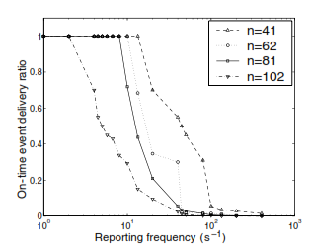
Effect of reporting frequency on On-time delivery
N – No. of Sources

Slide 45
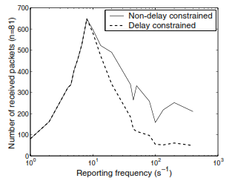
Effect of reporting frequency on Reliability

Slide 46
Delay-constrained event reliability depends on congestion and congestion depends on reporting frequency
Uses a combined congestion detection mechanism based on
Average Node delay → based on Channel contention level → computes from exponential weighted moving average of elapsed time
Local buffer level
T_{i} → Amount of time needed to provide delay-constrained event reliability for a decision interval i
T_{sa} →Application-speciﬁc communication delay bound
δ_{I} = DR_{i}/DR* → Delay-constrained reliability Indicator

Slide 47
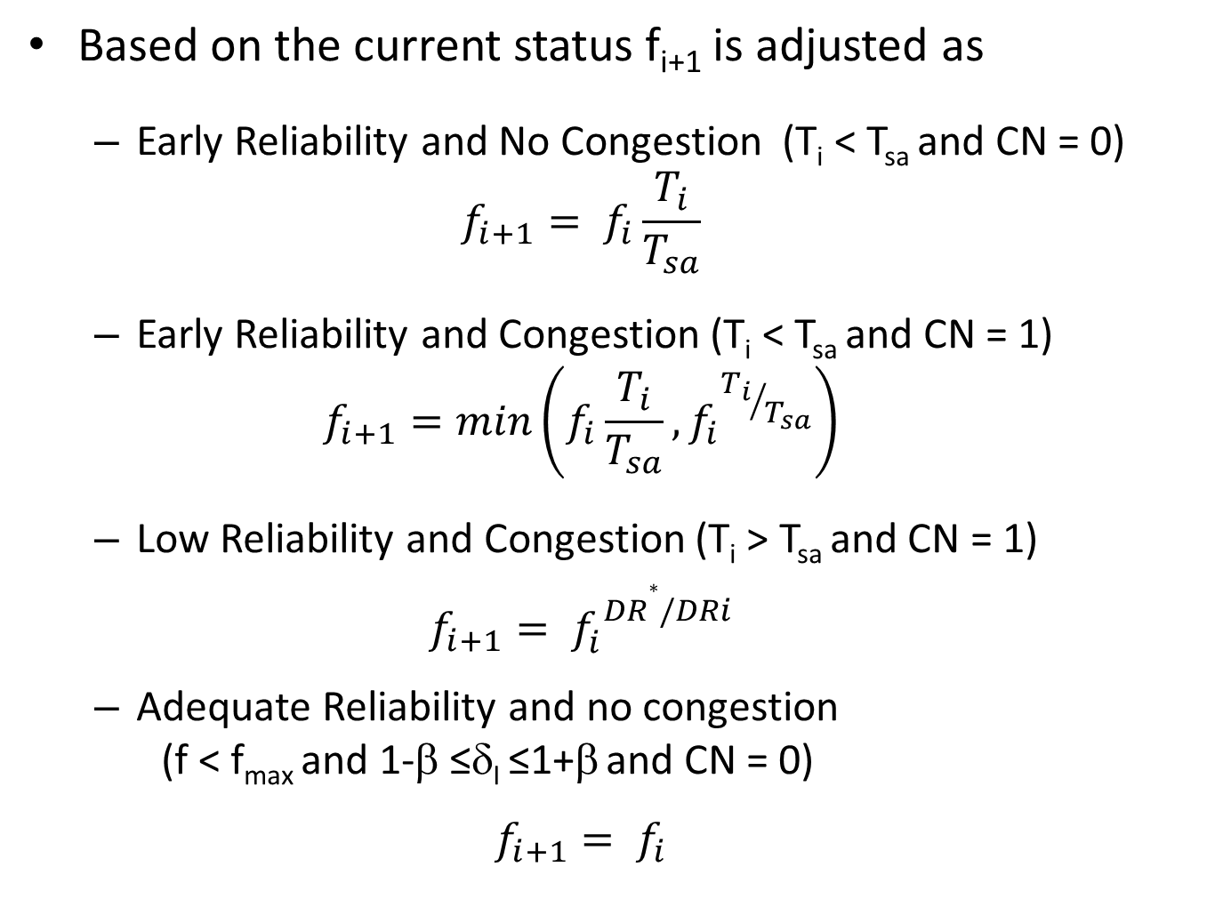
Based on the current status f_{i+1} is adjusted as
Early Reliability and No Congestion (T_{i} < T_{sa} and CN = 0)
$$f_{i+1}= f_{i}\frac{T_{i}}{T_{sa}}$$
Early Reliability and Congestion (T_{i} < T_{sa} and CN = 1)
$$f_{i+1}=min\left(f_{i}\frac{T_{i}}{T_{sa}}, {f_{i}}^{{T_{i}}/{T_{sa}}}\right)$$
Low Reliability and Congestion (T_{i} > T_{sa} and CN = 1)
$$f_{i+1}= {f_{i}^{}}^{DR∗/DRi}$$
Adequate Reliability and no congestion
(f < f_{max} and 1-β ≤δ_{I} ≤1+β and CN = 0)
$$f_{i+1}= f_{i}$$

Slide 48
Qualitative Evaluation
Merits
Self-conﬁguring
Performs efﬁciently under random, dynamic topology
Achieves real-time and reliable delivery
Average energy consumed per packet during communication is decreased as the [No Congestion, Adequate Reliability] state is approached through reporting rate control.
Addresses congestion control and timely event transport reliability objectives
Demerits
protocol operation is based on feedback from the sink, where a broadcast medium is assumed for the downstream trafﬁc. However, this may not be applicable to deployments where multi-hop communication is necessary.
Similar to ESRT, the same reporting frequency value is used for all sensors in a decision interval. This approach may not be suitable for networks where local interactions vary the network conditions signiﬁcantly.

Slide 49
